Slide 1


The Perils and Benefits of Technology for Mental Health
Anish John, M.D
Associate Medical Director,
Positive Sobriety Institute
Adjunct Assistant Professor,
Northwestern University
Feinberg School of Medicine,
Department of Psychiatry and Behavioral Medicine

Slide 2
Disclosures…None

Slide 3
Learning Objectives
Understand the scope, implications and current utilization trends of technology and the internet
Identify the potential risks of a digitally hyper-connected society as it pertains to mental health and recovery
Review and summarize the benefits of utilizing technology-based assessment and intervention strategies.

Slide 4

Smartphones are Ubiquitous
Constant interruptions
Making life easier?

Slide 5

FOMO
‘All about me’

Slide 6
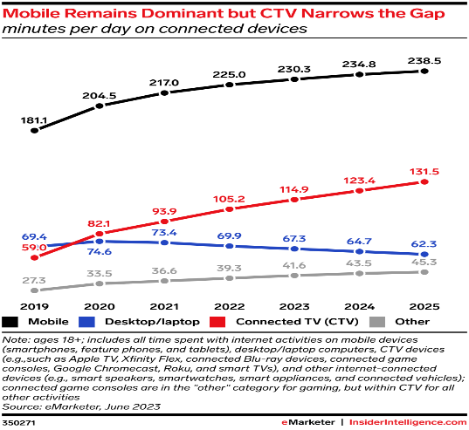
Smartphone usage

Slide 7

Higher rates of depression and anxiety among young adults who engage on multiple social media platforms
An increasing body of literature suggests that social media use is associated with mental health problems in adolescence.
Numerous cross-sectional studies and a limited number of longitudinal studies suggest that high levels of social media use are associated with internalizing problems- depressive and anxiety symptoms and externalizing problems such as issues with bullying and attention

Slide 8

Training our brains?
Stress- Fear-Memory pathways

Slide 9
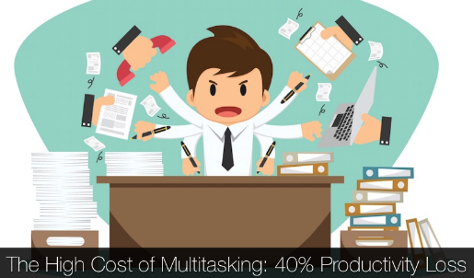
Short attention spans
Myth of Multi-tasking
Switch cost- up to 40%
APA- Multitasking: Switching costs

Slide 10
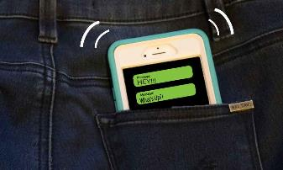
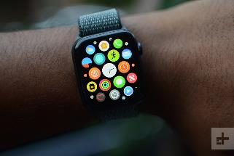
Phantom vibrations
Wearable tech?

Slide 11

Gaming disorders

Slide 12

Sneaking in some Variable ratio scheduling…

Slide 13

Sex/pornography addiction
Websites
Smartphone applications
Online forums
Frequently paired with substance use

Slide 14
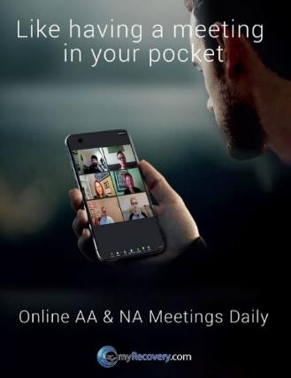
Positive aspects
Removing barriers for recovery support and continuing care

Slide 15


It’s cool to meditate now…

Slide 16
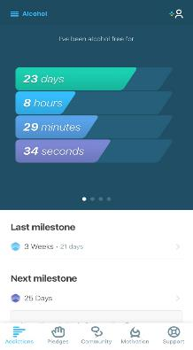
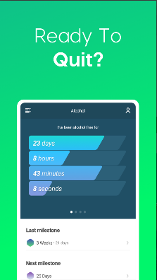
Sobriety oriented apps
I Am Sober

Slide 17
TECHNOLOGY-BASED ASSESSMENT OF COGNITION
AND EVERYDAY FUNCTIONING
Computerized cognitive assessment strategies
-Limitations
-Challenges for Remote delivery

Slide 18

CLINICAL VIRTUAL REALITY
Non-immersive VR
Immersive VR
Key aim- perceptually replace the outside world with the virtual world to psychologically engage users with simulated digital content designed to create a specific user experience.

Slide 19
CLINICAL VIRTUAL REALITY
Assessment of anxiety disorder or PTSD severity and subsequent exposure therapy
Distraction for patients undergoing acutely painful medical procedures
Physical/cognitive assessment/rehabilitation domains- stroke, TBI, CNS dysfunction
Effective in treating depression, paranoid delusions, and body image disturbances in patients with eating disorders

Slide 20
Virtual humans/avatars
Research showing their clinical usefulness as stimuli for exposure therapy for social phobias
Role-play training for social skills in people on the autism spectrum
Addressing intimate partner violence
Virtual patients that novice clinicians can use in practicing the skills required for challenging diagnostic interviews

Slide 21

ECOLOGICAL MOMENTARY ASSESSMENT (EMA)
Earlier stages of EMA -recording of behaviors (e.g., activity, sleep, smoking) or daily life experiences, such as stressors, through diaries
Passive Digital Phenotyping
Adherence Monitoring

Slide 22
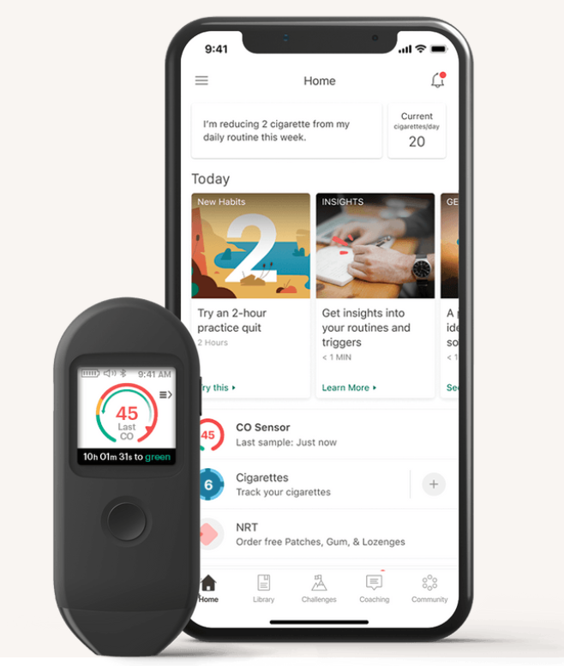
SMARTPHONE THERAPEUTIC APPLICATIONS
PIVOT is a digital smoking cessation app that includes human coaching with text messages, combined with smartphone-based carbon monoxide (CO) monitoring.
The CO sensor is an FDA-cleared medical device, and the program includes a multistage intervention following standard human-delivered smoking cessation strategies as well as nicotine supplementation.
Long-term data from (242/319) adult smokers in the U.S. who underwent the Pivot Breathe study, approximately 22% who made a quit attempt achieved continuous abstinence at three years. This achievement is particularly noteworthy in this population of which the majority (66%) were not ready to quit smoking at study entry. Pivot Breathe had a lasting impact, with the majority (≥76%) reporting the program helped them quit smoking, stay quit, or with their goals related to smoking. The present data supports the durability and effectiveness of Pivot in helping people quit smoking.

Slide 23
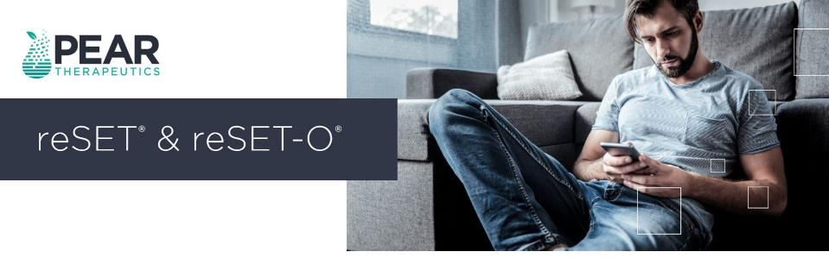
Prescription digital therapeutics
For individuals with substance use disorder, reset and reset-O was the first FDA-authorized prescription digital therapeutic that’s proven to increase abstinence and treatment retention.
82% of participants who were randomized to the device remained in treatment, compared with 68% of those in treatment as usual.
Abstinence was also higher in the active treatment group (77% vs. 63%). Given the typical attrition rates for opioid use disorder treatment (about 50% or more)

Slide 24
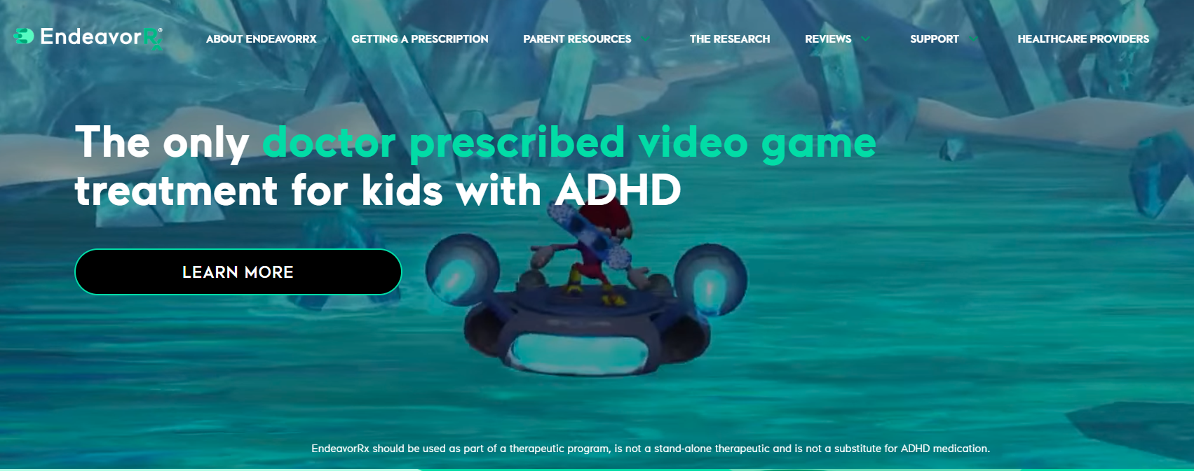
COMPUTERIZED COGNITIVE TRAINING AND
COGNITIVE REMEDIATION THERAPY
A treatment for ADHD recently approved by the FDA, EndeavorRx (generic name, AKL-T01), also used a train at home performance-based training intervention.
In a large-scale trial, AKL-T01 was delivered to children with ADHD in a video game–like interface via at-home play for 25 minutes per day, 5 days per week for 4 weeks.
The outcome measure was performance on an ADHD-relevant cognitive task, the Test of Variables of Attention (TOVA)
The treatment was significantly superior to a video game control condition

Slide 25

Artificial and Augmented intelligence in Health Care

Slide 26

Creation of algorithms that could identify lung and breast cancers, sometimes years before human detection
AI tools are now being generated to further streamline clinical practice, data sets can be created based on an enormous number of medical reports that function in tandem with natural language processing tools (like those utilized in ChatGPT).
AI tools can also help fill in the gap when it comes to human oversight in clinical practice.
Optimize numerous behind-the-scenes processes in a hospital system, such as predicting supply shortages or estimating surgery durations
Progress so far…

Slide 27
References
Associations Between Time Spent Using Social Media and Internalizing and Externalizing Problems Among US Youth JAMA psychiatry (Chicago, Ill.), 2019-12, Vol.76 (12), p.1-9
Elsevier Connect:-Addiction to modern technology: what the science says
Kaiser Family Foundation- cdc.gov
Phantom vibrations among undergraduates: Prevalence and associated psychological characteristics. Computers in human behavior, 2012-07, Vol.28 (4), p.1490-1496
Problematic smartphone use and relations with negative affect, fear of missing out, and fear of negative and positive evaluation. Psychiatry research, 2018-04, Vol.262, p.618-623
Durability of Abstinence After Completing a Comprehensive Digital Smoking Cessation Program Incorporating a Mobile App, Breath Sensor, and Coaching: Cohort Study (J Med Internet Res 2021;23(2):e25578)
Fulton F. Velez, Sam Colman, Laura Kauffman, Charles Ruetsch & Kathryn Anastassopoulos (2021) Real-world reduction in healthcare resource utilization following treatment of opioid use disorder with reSET-O, a novel prescription digital therapeutic, Expert Review of Pharmacoeconomics & Outcomes Research, 21:1, 69-76, DOI:10.1080/14737167.2021.1840357
Emerging experience with selected new categories in the ICD-11: complex PTSD, prolonged grief disorder, gaming disorder, and compulsive sexual behaviour disorder, (World Psychiatry 2022;21:189–213)
Technology and Mental Health: State of the Art for Assessment and Treatment Am J Psychiatry 2022; 179:897–914; doi: 10.1176/appi.ajp.21121254
How AI Can Improve Healthcare Delivery with Mozzi Etemadi, MD, PhD, Northwestern Medicine

Slide 28
Thank You
ajohn@windroserecovery.com

