Slide 1
From Tragedy to Triumph: The Pathway from ACEs to Growth
Joy Winchester
Behavior Coach/Interventionist

Slide 2
First some fun: just read the words
BLUE RED YELLOW ORANGE
GREEN BLUE PURPLE RED
PURPLE YELLOW RED BLUE
ORANGE BLUE YELLOW RED
RED GREEN ORANGE BLUE
PURPLE YELLOW BLUE ORANGE

Slide 3
Now say just the color of the word
BLUE RED YELLOW ORANGE
GREEN BLUE PURPLE RED
PURPLE YELLOW RED BLUE
ORANGE BLUE YELLOW RED
RED GREEN ORANGE BLUE
PURPLE YELLOW BLUE ORANGE

Slide 4
Read each word, words in boxes you will say the color
BLUE RED YELLOW ORANGE
GREEN BLUE PURPLE RED
PURPLE YELLOW RED BLUE
ORANGE BLUE YELLOW RED
RED GREEN ORANGE BLUE
PURPLE YELLOW BLUE ORANGE

Slide 5
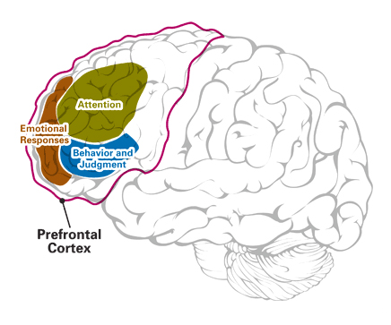
What Are Executive Functioning Skills?
Executive Functioning Skills Categories:
Cognitive flexibility (i.e., shifting from one task, perspective, or idea to another quickly and accurately); and achieve goals despite distractions
Inhibitory control (i.e., resisting temptations to act impulsively; maintaining selective attention despite distractions); and regulate our emotions and inhibit impulsive behaviors
Working memory (i.e., holding information in the mind long enough to work with it mentally self monitor and reflect)
Emerge during preschool years and don’t fully mature until early adulthood.
More indicative of success than IQ (predicts math and reading scores throughout the school years)
Executive skills are critical to independent living; exist only as potential (newborns have none), they require up to 24 years to fully develop
Prefrontal cortex guides behaviors, thoughts and feelings use representational knowledge.
Notes:
Prefrontal cortex guides behaviors, thoughts and feelings using representational knowledge. These are fundamental cognitive abilities. Can be weaker for those with ADHD or EF deficits/symptomology.

Slide 6
Negative Impact on Development of Executive Functioning Skills
Resilience- Genetic impact on resilience (the brain comes pre-wired, not hard-wired)
Stress
Caregiver’s Executive Functioning Skills Development
Poverty
Overuse of Technology
Adverse Childhood Experiences

Slide 7
Hidden Epidemic- Stress and Trauma
What if we knew the cause of most chronic disease, most mental illness, and most violence in America?
Research indicates that traumatic stress in childhood is the leading cause of morbidity, mortality and disability in the Unites States.
ACEs- Adverse Childhood Experiences
64% of adults report Adverse Childhood Experiences (trauma); 87% have more than one ACE.
There are 10 ACEs:
Physical, sexual, emotional abuse
Physical and emotional neglect
Witnessing a mother be abused
Living with a family member with a mental illness, incarcerated, or addicted
Losing a parent to separation, divorce or other reason

Slide 8
Current ACEs Data
2/3 of population has at least 1 ACE
1 in 8 has four or more ACEs (2019) data now shows 1 in 6 (2021)
4 times greater risk of alcohol abuse
7 times greater risk of drug use
4.5 times greater risk of depression
12 times greater risk of suicide
2019 Study of opioid users in Tennessee (patients on Medical Assisted Treatment)
For every 1 point increase on the ACE scale, there was a 17% increase of relapse
If the treatment was trauma-informed, a 2% risk in relapse was noted

Slide 9
ACEs: Impact on Children

Slide 12
ACES and Impact on Ageing Brain
Higher ACE scores correlated with:
Higher rates of dementia
Higher rates of Alzheimer’s Disease
Rapid cognitive decline-accelerated ageing process
Quote from research: “It was striking that the older women and men who had a history of any adverse childhood experience, and also select types of adverse childhood experiences, were more likely to have objective signs of physical mobility impairment, cognitive impairment including problems with memory and concentration, and also to report difficulty carrying out core activities of daily living,”
Adults between the ages of 50 and 97 who had experienced violence as children, for example, were 80% more likely to have difficulty with daily living activities and 40% more likely to have mobility problems compared to those who had not. Older adults who reported having an unhappy family life as children were 40% more likely to have some degree of cognitive impairment

Slide 13
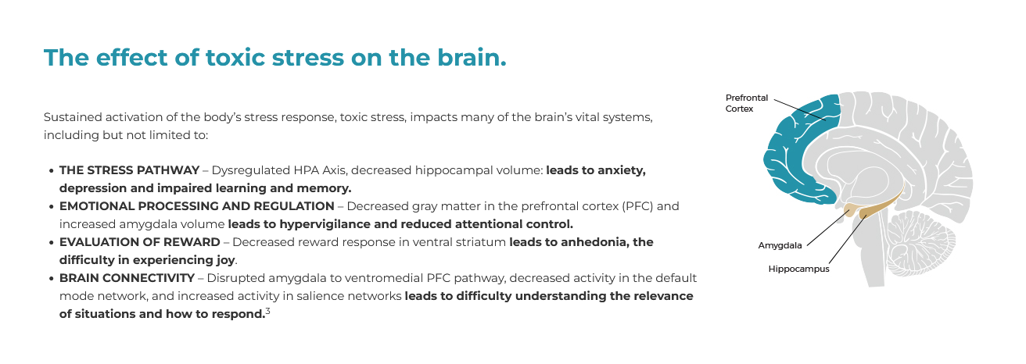

Slide 14
Top-Down Control
Neocortex is in control-keeps the limbic system and reptilian brain
When we get angry, instead of reacting we stop and think
We can put our strategies in action
Morals and Ethics guide us- right and wrong
We are able to think of the consequences of our actions in the future
We make decisions best for all involved not just us
We can talk it out, we can let it go, we can walk away

Slide 15
Bottom-Up Control
The limbic system is in control- 15 second life
It is not about morals, personality, or choice
It is about instinct, emotionality, and survival
Traditional discipline will not work, there is no understanding of cause and effect
No understanding of “right” and “wrong”
What is felt- impulse, desire, or need in the moment is what is important regardless of consequences.
Example in your own life: super stressed eat chocolate no regard for consequences just want to satisfy need.

Slide 16
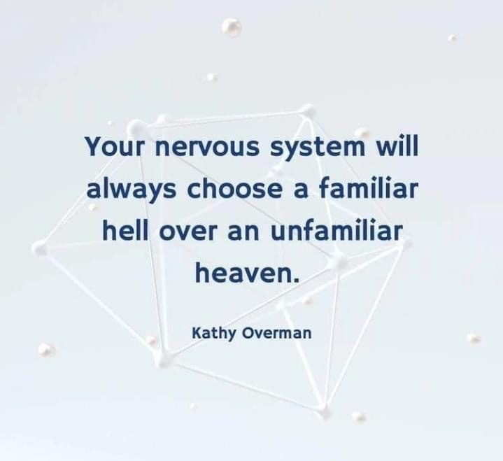

Slide 17
What We Have Done Right
Understanding: Adversity is not your destiny
Understanding that children and adults are whole people and are more than the worst things that have happened in their lives
ACES is understood in many fields now: education, medicine, law enforcement, etc
Acknowledging that ACES can have a negative impact at childhood and into adulthood has changed systems of support
Mental health is becoming an accepted phrase and the stigma is slowly fading

Slide 18
John Hopkins 2019- Positive Childhood Experiences
Findings: Kids with high PCE’s become adults who can seek and get care and support, which improves symptoms even if mental health illness is present.
The relationship between PCE’s and good mental health is dose-responsive.
The more a child gets, the better adult health.
The absence of PCEs may be linked with more mental health problems than the presence of ACEs
PCEs:
Ability to talk with family about feelings.
Felt experience that family is supportive and difficult times.
Enjoyment and participation in community traditions.
Feeling of belonging in high school
Feeling of being supported by friends.
Having at least two non-parent adults who genuinely care.
Feeling safe and protected by an adult at home.

Slide 19
Positive Childhood Experiences (PCEs)

Slide 20
PCEs on Mental Health

Slide 21
ACEs and PCEs

Slide 22
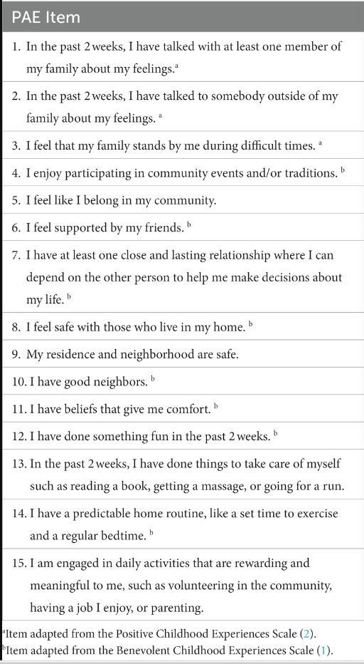
Positive Adult Experiences (PAEs) 2023 Study

Slide 23
Positive Adult Experiences (PAEs)
Steeling Effect: one may experience stress or adversity in childhood and this strengthens resilience later in life. This cannot be assumed for everyone.
Turning Points: beneficial experiences during adulthood serve to combat prior traumatic experiences and improves health.
PAEs are classified as “turning points” as these are cumulative events which can mitigate the negative impact of ACEs.
PAEs:
Linked to less anxiety and depression in adulthood regardless of ACEs and PCEs
Particularly protective of moderate-severe anxiety and depression among those with low PCEs and high ACEs
Linked to better mental health overall and strong association with positive outcomes

Slide 24
Takeaway from PAEs Study
“The presence of adversity in childhood does not negate the ability for positive connections in adulthood and the development of adult social connection and support.”

Slide 25
Links to Resources
ACES Connection https://www.acesconnection.com/blog/the-developing-brain-and-adverse-childhood-experiences-aces
Beacon House https://beaconhouse.org.uk/
Aces Too High: https://acestoohigh.com/
Nadine Burke Harris: The Deepest Well (Ted Talk and Book)
Donna Jackson Nakazawa: Childhood Disrupted (book)
Positive Adult Experiences: Frontiers | Positive adult experiences as turning points for better adult mental health after childhood adversity (frontiersin.org)
Benevolent Childhood Experiences: BCEs_10_English (careinnovations.org)
Positive Childhood Experiences: Positive Childhood Experiences May Improve Mental Health | Psychology Today
Contact: Joy Winchester joymwinchester@outlook.com

