Slide 1
The Power of Group Therapy
Sandra Frazier, MD-- APHP Medical Director
Rob Hunt, D. Min—APHP Director
Celia Cantor, LPC

Slide 2
Objectives
1. Explore guidelines which foster psychological safety in a group.
2. Identify how the group process improves self-awareness and knowledge
3. Describe potential benefits of group therapy.

Slide 3
What is Group Therapy?
It is a place where you come together with others to share problems or concerns, to better understand your own situation, and to learn from and with each other.

Slide 4
History of Group Therapy (in the U.S.)
Before 1900’s
Large groups (e.g., immigrants, poor, etc.)
Groups for people with tuberculosis (1905)
Moreno (1921) – Theater of Spontaneity (psychodrama)
AA founded in 1930’s
Introduced in the 1940s, though Alfred Adler (“Collective Counseling”) and a few others
Early efforts similar to today’s group guidance and psychoeducational groups

Slide 5
History of Group Therapy (cont.)
WWII and its effects led to popularization of group therapy
The 1960’s Human Potential Movement
Founded on belief that most people only use a small percentage of their capabilities but that within a group experience, they can recognize their full potential.
Started proliferation of personal growth groups
Gestalt groups
T-Groups: Individuals come together to learn how to work in a group and to effect interpersonal change.
Encounter Groups: Designed to help normal individuals remove blocks that inhibit their functioning
Marathon Groups: An intensified encounter group that meets for a long period of time (e.g. 8 hours or a whole weekend.)

Slide 6
Types of Groups
Task Groups: A group that comes together to perform a task that has a concrete goal (e.g. community organizations, committees, planning groups, task force).
Guidance/Psychoeducational Group: Preventative and educational groups that help group members learn information about a particular topic or issue and might also help group members cope with that same issue (e.g. transition group to prepare students to enter high school etc.)
Counseling/Interpersonal Problem-Solving Groups: These groups help participants resolve problems of living through interpersonal support and problem solving.

Slide 7
Types of Groups (cont.)
Psychotherapy Groups: These groups focus on personality reconstruction or remediation of deep-seated psychological problems.
Support Groups: These deal with special populations and deal with specific issues and offer support, comfort, and connectedness to others.
Self-help Groups: These have no formal or trained group leader. (e.g. Alcoholics Anonymous or Gamblers Anonymous.)

Slide 8
In the realm of mental health,group therapy is gaining increasing recognition.
Depression, Anxiety
Substance Use Disorders
PTSD
Eating Disorders
OCD
ADHD
Schizophrenia

Slide 9
Rules of Engagement
Confidentiality
Privacy
Dignity
Violence or Intimidation
Alcohol and Other Drugs
Exclusive Relationships
Gossip
Attendance
Discharge

Slide 10
Concerns in Group Work
Participant Selection: Screening is needed with counseling and psychotherapy groups. Some people are not well suited for group work.
Group Size: Varies from 3-4 members to several hundred depending upon the group (e.g. psychotherapeutic or task group). Group counseling and psychotherapy generally work best with 6-8 members.
Length and Duration of Sessions: Individual sessions are usually 50 minutes, group sessions range from 1-2 hours. Session duration can be only once or in some cases might last for years (e.g. open-ended psychotherapy group).

Slide 11
Concerns in Group Work (cont.)
Group structure can be open (allows members to enter and leave the group as needed) and closed (only the group members who started at the beginning are in the group at the end).
Ethics: Confidentiality is hard to guarantee due to the number of participants.
Group Evaluation: Outcome measurements are difficult to obtain.

Slide 12
Process of Self Knowledge

Slide 13
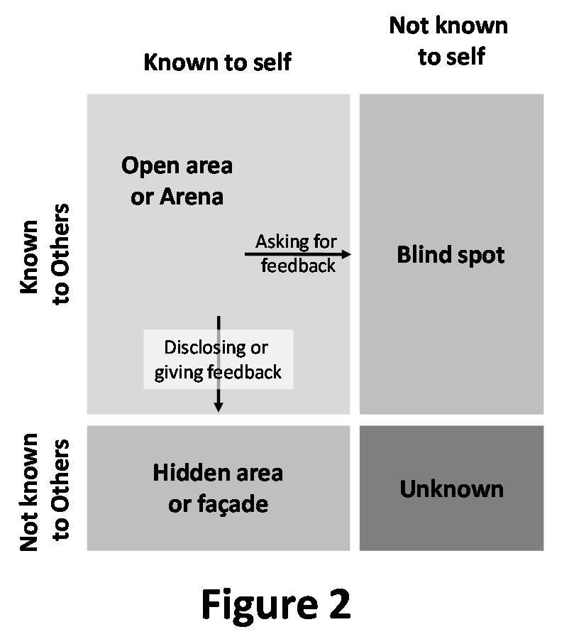

Slide 14
Personal Benefits of Group Therapy
Acceptance
Break from social isolation
Relief from terminal uniqueness.
Improves self-esteem and self-worth
I am not alone
Pulls us out of morbid self absorption
Inspires hope

Slide 15
Advantages of Groups
Groups provide a social atmosphere that is similar to the real world
Groups provide more opportunity for social learning
Participants can more easily learn interpersonal skills
Members can practice new interpersonal skills on each other
Particularly developmentally appropriate for adolescents
Groups are cost effective
Groups provide commonality (e.g. “I’m not the only one with this problem”)

Slide 16
Advantages of Groups (cont.)
Group experiences help members become aware of how others view them and what impact their behavior has on others
Group dynamics can replicate family of origin dynamics and thus help group members work out old family issues
A group member makes public statements regarding change and thus is more likely to follow through with stated behavior
Members receive feedback/support/challenge that encourage or facilitate change
Groups offer diversity of perspectives

Slide 17
Your Turn!
Share with group members something about yourself that might surprise them.
OR
Describe a childhood event that greatly impacted you.

Slide 18
Questions/Comments

