Slide 1

Motivational Interviewing &
The Brief Negotiated Interview –
A Collaborative Conversation
Shanna McIntosh, MS, AADC
Director, VitAL
semcintosh@ua.edu
Audra Toney, MSW
Project Coordinator, VitAL
awtoney@ua.edu

Slide 2

Disclosure/Conflict of Interest
There are no financial disclosures or conflicts of interest to report in relation to this program.

Slide 3
Objectives
Define the brief negotiated interview model
Examine the evidenced-based practice model of brief intervention, the brief negotiated interview (BNI)
Explain the principles of motivational interviewing and how to apply to the BNI
Apply BNI techniques through group role play

Slide 4
Background and Context
VitAL is a trusted partnership between Alabama state agencies and the University of Alabama. VitAL is a research, implementation, training, and education initiative that aims to improve the lived experience of Alabamians with mental health, substance misuse, and trauma-related challenges.
The VitAL team works with community and organizational stakeholders across all of Alabama’s 67 counties.

Slide 5
Motivational Interviewing (MI)
“Motivational Interviewing is a client-centered, directive method for enhancing intrinsic motivation to change by exploring and resolving ambivalence.”
- Miller & Rollnick (1991)
Notes:
Motivational Interviewing is an effective, evidence-based technique.
It (MI) is a collaborative, patient-centered counseling style for eliciting behavior change by helping patients explore and resolve ambivalence about change.
Motivational Interviewing recognizes that patients may be at different stages of awareness and readiness to change and facilitates their progress through those stages.
The central goal of MI is to increase the intrinsic motivation to change that arises from internal forces rather than external pressures.

Slide 6

Motivational Interviewing
“Motivational Interviewing is a soft way of asking people to take a
hard look at themselves.”
- Rosa Ontiveros
Notes:
I have included my FAVORITE motivational interviewing quote. Rosa Ontiveros stated, “Motivational Interviewing is a soft way of asking people to take a hard look a themselves.”

Slide 7
Goal of Motivational Interviewing (MI)
To create discrepancy between present behavior and broader goals.
HOW?
“Afflicting the comfortable”
Create cognitive dissonance between where one is and where one wants to be.
Notes:
Creating discrepancy between the patient’s goal or values and their current behavior is the goal of Motivational Interviewing.
For example: A patient discloses “I really love my husband. He is a great provider, but he gets so upset when I drink. Sometimes I just think it’s best to drink when he isn’t around.” As the provider, you could respond with “It sounds like your marriage is important to you, but I’m also hearing that your husband prefers that you not drink. Is that correct?” This will help shift the patient’s thoughts to see that while she enjoys drinking alcohol, she also enjoys being married and really cares what her husband thinks of her choices.
HOW do we create this discrepancy?
The goal of most treatment is to “comfort the afflicted”. The goal of Motivational Interviewing is to “afflict the comfortable” by helping the patient recognize the distance between where they are and where they want to be.
Let’s go back to the example of the patient’s husband who does not want her to drink so much.
To create cognitive dissonance the provider could say: “I’m hearing you say you love your husband, but that he doesn’t like it when you drink. I also understand that you enjoy drinking wine and prefer to continue to do so. What are the good things about your marriage?” (Allow the patient time to list several good things.) Once the patient has listed all the good things about her marriage, ask her the good things about drinking.
The goal here is to have more good things about her marriage than about drinking. When she sees that she has more positive things about her marriage than about drinking wine, you have helped to create discrepancy.
Now you can talk with the patient about where to go from here.

Slide 8
Principles of Motivational Interviewing

Slide 9
Empathy
Express Empathy
I can see that it is difficult to give up
chocolate.
I can see how drinking/relaxing
with friends is hard to give up.
I understand it can be inconvenient
to check your blood sugar at times.
Notes:
The first principle of Motivational Interviewing is EMPATHY.
Empathy means you see the world through the patient’s eyes and think about things in the same way the patient would.
Empathy means you can see or understand how the patient sees a situation. However, it does not mean you are agreeing with their view.
Read examples from the slide!

Slide 10
Self-Efficacy
Support Self-Efficacy
1. You’ve accomplished many
things in your life.
2. You’re very determined and I
know you’re up to this
challenge.
3. You work hard and provide
for your family.
Notes:
The next principle of MI is self-efficacy.
Self-efficacy refers to the individual’s belief in his/her own ability to change a behavior. The patient must believe that change is possible to have hope about making difficult changes. The patient might have tried to change in the past but not succeeded.
The practitioner supports the patient’s self-efficacy by focusing on the patient’s previous successes and pointing out the skills/strengths the patient already has.
For example: You might have a patient that smokes a pack of cigarettes daily. He might tell you “It’s so hard to quit smoking. I’ve tried before and it didn’t work. I quit for 2 days and went right back to it.” The provider can respond, “You quit smoking for two days? That is great! What did you do that time to stop smoking?” Allow the patient time to answer. He might say. “I just quit cold turkey, but after 2 days I couldn’t take it anymore.”
The provider can then respond, “That is great that you were able to stop for two days without any other interventions. Do you think with the support of 1-800 QUIT NOW you might be even more successful?” The patient viewed his last attempt to quit as a failure, but the provider pointed out he had 2 successful days.

Slide 11
Resistance
Roll with Resistance
1. If you don’t want to talk about
smoking cessation, we can talk
about what brought you in to see
the doctor today.
2. We don’t have to talk about weight
loss. What brings you to the office
today?
3. If you prefer not to discuss your
marijuana use, we can talk about
your new job. How is that going?
Notes:
When working with patients, we all know resistance is often involved.
All providers encounter patient resistance at times.
Resistance in treatment occurs when the patient experiences a conflict between their view of the behavior we are suggesting they change and the view of the provider.
Resistance also occurs when the patient feels as though their freedom/autonomy has been infringed or taken away. Resistance is usually based on the patient’s ambivalence about change.
Practitioners can avoid resistance by “rolling with it”; avoid challenging the patient’s statements and encourage them to develop possible solutions rather than outlining solutions for them.
The examples you see on the slide take the focus off the behavior the patient is resisting to change and shifts their focus to something else that might help them see a reason/become motivated to change.
READ EXAMPLES ON SLIDE!

Slide 12
Discrepancy
Develop Discrepancy
I hear you say that your health is a priority and that you want your cholesterol numbers to decrease. You also mentioned you do not take your cholesterol medication. How do you plan to decrease your cholesterol?
I hear you say that you love your children and want to regain custody. You also mentioned you continue to smoke marijuana. How do you plan to regain custody of your children?
Notes:
Motivation for change occurs when a patient perceives a mismatch between where they are and where they want to be.
The practitioner works to develop this motivation for change by examining the discrepancies between the patient’s current behavior/situation, their values, and future goals.
Look at the slide: These are examples of a provider developing discrepancy.
READ SLIDE!

Slide 13
Three Essential Elements of MI
MI is a particular kind of conversation about change (counseling, therapy, consultation, method of communication).
MI is collaborative (person-centered, partnership, honor autonomy, not expert-recipient).
MI is evocative (seeks to call forth the person’s own motivation and commitment).
Notes:
There are three essential elements of MI:
Using Motivational Interviewing skills in a session with a patient does not involve a practitioner telling the patient what to do. MI is a conversation between the provider and patient. A conversation which helps the patient develop a desire to change their behavior.
Each patient is an expert on themselves so the practitioner should treat them as the expert. We might be the expert in our profession; we know a lot about our profession, but we do not know the patient in this way. Allow the patient to tell you about themselves and about their situation; being sure you listen to their thought process so you can effectively assist them in making a behavior change.
Be evocative! Say to your patient, “You have what it takes to do this!” The patient will likely feel like they cannot make the desired change, but we can help them see they have what it takes!

Slide 14
The Spirit of Motivational Interviewing
Collaboration: Patient knows themselves the best; provider creates an atmosphere for partnership.
Evocation: Patient wants changes; provider must evoke this from patient.
Autonomy: Patient must have own sense of direction; provider respects this.
Notes:
The spirit of MI involves collaboration, evocation, and autonomy!
Motivational Interviewing is collaborative. It is done with the patient, not to the patient. We should always make them feel as if they are a part of the session ... Not that they are being judged. If you and the patient are having a conversation (if you are using Motivational Interviewing skills) it will be a collaboration and the patient will feel valued!
Evocation- This is basically finding out what the patient lacks and instilling it in them...saying "I know you have what you need to get through this, we will find it together“.
Last, you want the patient to have complete freedom “to be” and “to choose.” If the provider does everything for the patient, they will not believe or feel they can do it without their provider. As the provider, it is your job to show the patient that he/she has the skills necessary to make this change and that they have the ability to continue the change after the sessions end.

Slide 15
The Opposite
Confrontation: Patient does not understand the situation; provider imposes negative thoughts on the situation.
Education: Patient is thought to lack knowledge; provider forces education on patient.
Authority: Patient is thought to be lacking in direction; provider tells patient what they must do.
Notes:
If we collaborate with our patients, we are more likely to experience positive outcomes. If we assume patients do not understand their situation, we are assuming they are unable to help themselves.
Opposite from the Spirit of MI is…. Being confrontational, assuming the patient isn’t knowledgeable about their use, and being authoritative.
These are things we should AVOID!
Confrontation: If the provider is confrontational, the patient is not likely to talk about the behavior you are encouraging them to change. Instead, they are likely to become more ambivalent about making the change.
Education: As the provider, we should not throw information at our patients. Ask the patient what they know. For example: If you have a patient using marijuana you could start by saying “Has anyone talked to you about your marijuana use before?” Or “What do you know about marijuana use?” Once you have an idea of what they do or do not know, ask the patient, “May I provide you with some information about how marijuana use affects the body?”
Not only have you asked the patient for permission to provide more education, but you are telling them things they do not already know. If we begin by throwing education at them, the patient will likely feel we think they are not knowledgable.
Authority: If you help your patient see they have the skills within them to change their behavior, you are showing them you are working with them rather than telling them what to do. We are here to help the patient, not to be authoritative.

Slide 16

Questions ?

Slide 17
Brief Negotiated Interview
“BNI”
Notes:
Now that we all know what Motivational Interviewing is, let’s talk about how to use those skills to do a Brief Negotiated Interview.

Slide 18
What is a Brief Negotiated Interview ?
A Brief Negotiated Interview (BNI) is a brief, motivational, and awareness raising intervention used to encourage behavior change.
Notes:
A Brief Negotiated Interview is a “specialized” brief intervention for the medical setting.
It is a semi-structured interview process that is a proven evidence-based practice.
The BNI helps health care providers explore health behavior change with patients in a respectful, non-judgmental way within a small period of time.
Since it uses Motivational Interviewing techniques, it enhances the patient’s motivation to make a behavior change.

Slide 19
A BNI …
Can be completed in 5-15 minutes.
Can be used in any setting.
Can be used with any patient.
Can be used to address ANY behavior change!
Notes:
With AL SBIRT (Screening, Brief Intervention, and Referral to Treatment) we frequently use the BNI in addressing substance use; however, that is not the only time it can be used.
A BNI can also be used with patients who have chronic health conditions and/or those who are not compliant with treatment or medications.
The BNI can be:
1) Completed in as little as 5-15 minutes but can last up to 15 minutes if time permits.
2) Can be used in any setting …… ER, In-home care, clinic, etc.
3) Can be used with any patient.
The BNI can be utilized to address ANY behavior change.

Slide 20
Goals of the BNI
Educate the patient
Increase the patient’s awareness
Motivate the patient towards behavior change
Assist the patient in making choices to make the desired change
Notes:
The goals of the BNI are fluid.
Since no two patients are the same, practitioners must remain open-minded and fluid in what they attempt to accomplish.

Slide 21
Steps of the BNI
Raise the Subject and Build Rapport
Provide Feedback
Offer Advice
Enhance Motivation
Negotiate a Plan
Notes:
Brief Negotiated Interventions are short dialogues between the medical provider/nurse/social worker and the patient that typically involve:
Raising the subject of behavior change
Feedback
Encouragement
Simple advice/brief counseling
Goal setting
Follow up
We are going to break each step down in the next several slides.

Slide 22
Raise the Subject &
Build Rapport
Raise the subject
“Thank you for coming in. Would you
mind telling me a little about what
brought you to the clinic?”
“Can you tell me more about ________?”
Discuss the pros and cons
Reinforce what has been said
Notes:
The first step is to raise the subject.
This is also where you build rapport with your patient.
You see an example of a provider raising the subject on the slide.
Let’s say the patient has had significant weigh gain over the past six months. The provider could say, “Thank you for coming in today. I see you have experienced weight gain since your last visit. Would you mind taking a few minutes to talk about it?”
The provider could say, “Can you tell me more about what a typical meal looks like for you?” Once the patient begins telling the provider what their typical meal looks like (specific foods, quantity consumed, etc.) you can discuss the pros and cons aka the good and not-so-good lists of their food choices, etc. … (“What are some good things about fast-food restaurants? What are some not-so-good things about frequently eating at fast food restaurants?”).
You can use reflections and summaries to reinforce what was discussed.

Slide 23
Provide Feedback
Ask permission.
Provide information.
Link behavior(s) to any known consequences/medical conditions.
Notes:
Throughout the BNI, the patient has told you quite a bit of information about the undesirable behavior. You have a good idea of what they know and what they don’t know about it.
This is the time to offer feedback!
Start by asking permission, “May I share some information with you about how weight gain affects our health?”
Provide any information you have at this point. Involve the patient by asking, “Were you aware of these the health risks associated with weight gain?”
Help the patient to see that their current behavior is linked to negative consequences.
For example, if the patient came to the clinic due to high blood pressure, but they have had significant weight gain, this would be a link to their high blood pressure. Explain the correlation to the patient: “Were you aware your weight could be linked to high blood pressure?” Once the patient knows this information, they might be more willing to change their behavior.
You can also point out how a diet change might be beneficial for a patient who has been diagnosed with diabetes, etc.

Slide 24
Offer Advice
Provider: May I offer you some advice?
Patient: I guess so…..
Provider: I would like for you to consider cutting down on your tobacco use.
OR
“Smoking cigarettes may cause some serious health problems. I would like you to consider cutting down or quitting.”

Slide 25
Enhance Motivation
DECISIONAL BALANCE
Key tool in which the patient considers the pros and cons of their current behavior and the pros and cons of changing the behavior.
Many have never stopped to think about the negative aspects of a behavior, so this conversation encourages them to foster internal motivation.
Notes:
Many people change on their own. However, some do not and need some help from us. That is okay.
Remember in Motivational Interviewing we talked about asking the patient for the good things about their use, as well as the not-so-good things? This is where we use it in the BNI.
When you ask a patient for the good and the not-so-good about their behavior, they usually do not realize they have more not-so-good than good until they break it down. When you point out “I see that you have some things you like about drinking. I also see that you have more not-so-good reasons about drinking. Did you realize that?” When the patient answers (usually they don’t realize this) ask them what they think about that.
You may also ask them the following questions: What do you like about smoking? Now, what’s not so good about smoking?
This is the decisional balance. This is the time the provider can tip the scales and hopefully the patient will see that, perhaps, a change in their drinking pattern (or whatever change they are trying to make) would be a good thing.
Look at the 2nd bullet point. If your patient is still unsure about changing even after the good and not-so-good discussion, think about asking: Is there a cost to your tobacco use?
Does your smoking have any affect on your work or family life?
They might first answer with the money they spend on tobacco or alcohol. But they might also admit they’ve received a DUI. They might also discuss how their loved ones have asked them to cut back and this would be a way to show how the patient’s behavior affects their family.
When they are asked what brought about the change, patients often say they “just thought about it,” meaning they evaluated the consequences of their current behavior and of changing before making a final decision.
You can do the same thing with the costs of changing on one side and the benefits of changing on the other side. This exercise will help you look at the good things and not-so-good things about changing.

Slide 26
Negotiate a Plan
Simple
Realistic
Specific
Attainable
Follow-up timeline
Notes:
The final step is to negotiate a plan.
The plan should be simple, realistic, specific, attainable, and should include a follow-up.
The first thing to point out is that the patient should develop their own plan. The provider is there to help, but the ideas should come from the patient.
If the patient develops the plan, they are more likely to follow through.
As the provider, help keep the patient to a plan that is simple and realistic. Help them to identify specific goals that are attainable. Also, help them to create a follow up timeline.
For example: “I hear you saying that you are going to cut back to 3 cigarettes per day and you are going to journal your thoughts and progress daily. When you come back to see me next week, I would like for you to bring your journal so we can discuss your progress.” The patient identified that they wanted to cut back to 3 cigarettes per day and that they would journal their progress. Another appointment was made to discuss the progress. This is simple, attainable, and follow up initiated.

Slide 27

Let’s see a BNI in action!
Notes:
AFTER VIDEO:
What did the practitioner do well? He asked permission as he raised the subject, he used open ended questions, he used the good and not so good list.
He asked her if her alcohol use affected her family. She said she had not thought about it.
The doctor helped the patient to see that her drinking pattern was risky despite her ambivalence.

Slide 28
BNI
Notes:
Now that we have discussed the Brief Negotiated Interview, let’s watch a BNI in action!
After Video:
Provider did a good job of linking patient’s diagnosis of depression to her drinking.
Provider asked the patient what would help her cut back on her drinking?
Provider also asked the patient what other things she could do to “relax.”
Provider used good and not-so-good comparison with the patients drinking.

Slide 29
Questions ?

Slide 30
BNI Activity
Participants will form groups of two.
  One participant will act as the provider.
  One participant will act as the patient and determine a behavior
  he/she would like to change.
Using the BNI example algorithm for guidance, the participant acting as the provider will complete a brief intervention with the participant acting as the patient.
REMINDER: The brief intervention should be brief AND thorough.
  6 minutes
Notes:
**HAND OUT BNI EXAMPLE ALGORITHMS**
Participants will form groups of two.
One participant will act as the provider.
One participant will act as the patient and determine a behavior
he/she would like to change.
Using the BNI example algorithm for guidance, the participant acting as the provider will complete a brief intervention with the participant acting as the patient.
REMINDER: The brief intervention should be brief AND thorough. We mentioned earlier that the BI should last 5-15 minutes but for this activity we are going to say 6 minutes.
6 minutes
AFTER ACTIVITY: BRIEF Feedback Discussion
Difficult to complete in 6 minutes?
How did it feel asking about the “patient’s” desired behavior change, etc?

Slide 31
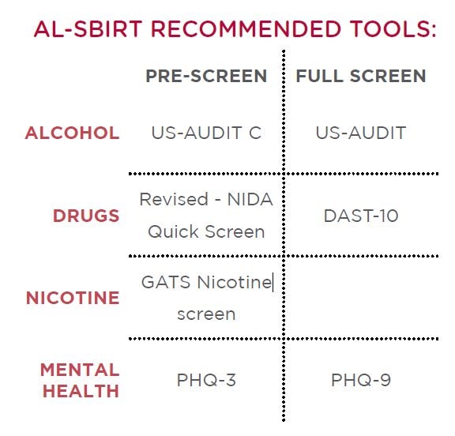
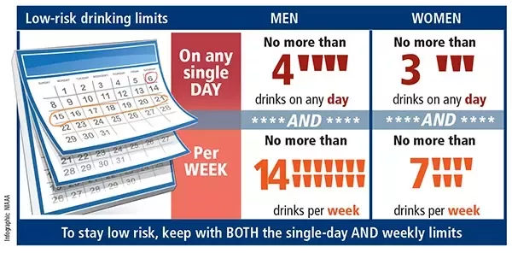
SBIRT
(Screening, Brief Intervention & Referral to Treatment)
Notes:
We have talked a lot about the MI and the BNI and saw some great examples of the BNI in action but I wanted to share one additional thing with you today.
It is a tool that is effective in assessing patients for risky substance use and mental health and provides patients with education surrounding healthy drinking limits, this process is referred to as SBIRT.
SBIRT is an acronym for Screening, Brief Intervention, and Referral to Treatment.
Simply put, all patients ages 19+ are screened annually for substance use and mental health.
The screening tools utilized are the US- AUDIT C, US-AUDIT, Revised NIDA Quick Screen, DAST-10, GATS Nicotine Screen, PHQ-3 & PHQ-9.
Based on the patient’s responses, their scores indicate a level of risk associated with their substance use. Based on their risk level, patients receive positive feedback, a brief intervention, or a referral to treatment, if they accept.
SBIRT has been implemented in various locations throughout the state from Emergency Rooms, In-home care agencies, FQHC clinics, Primary Care Clinics, ADPH clinics, and the VA among many others.
If this is something you would be interested in hearing more about, please reach out to me as I would love to speak with you about it. We have a toolkit that has been developed and are able to offer free training to assist with implementation.

Slide 32




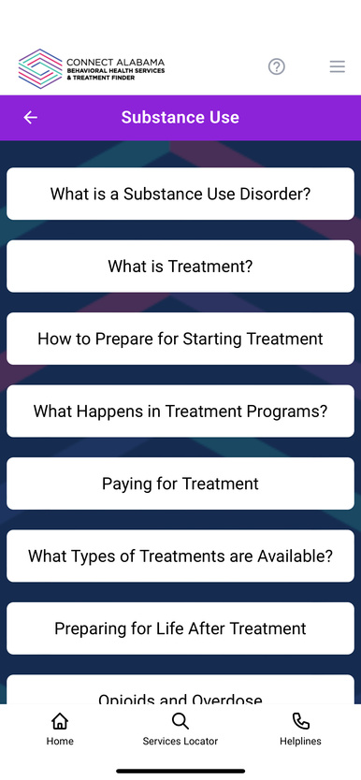
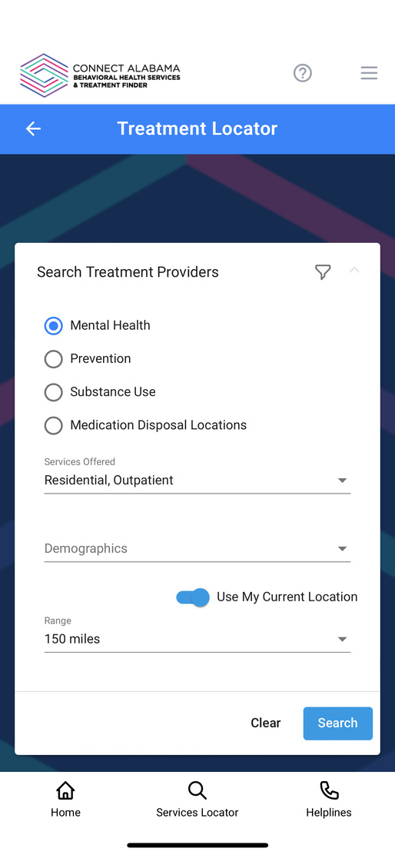
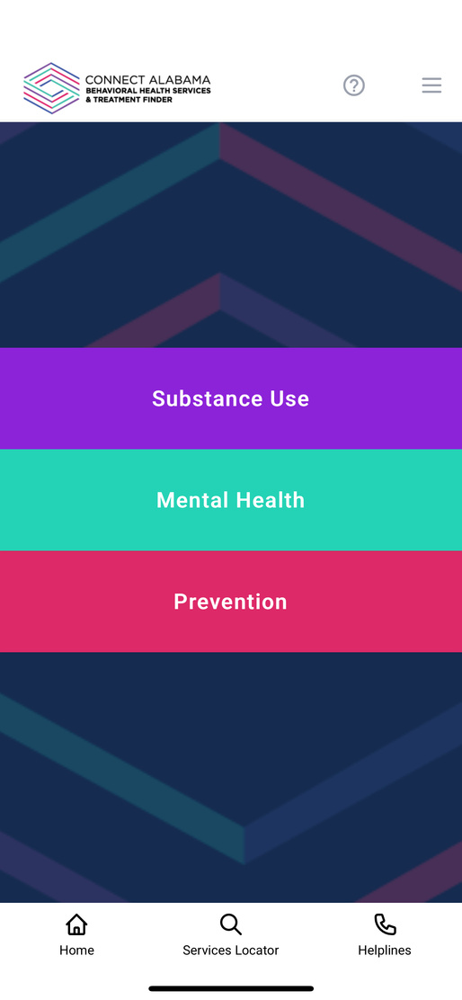



www.medical.com
Connect Alabama
HELP is in your hands.
A partnership between ADPH, ADMH, and VitAL

Slide 33
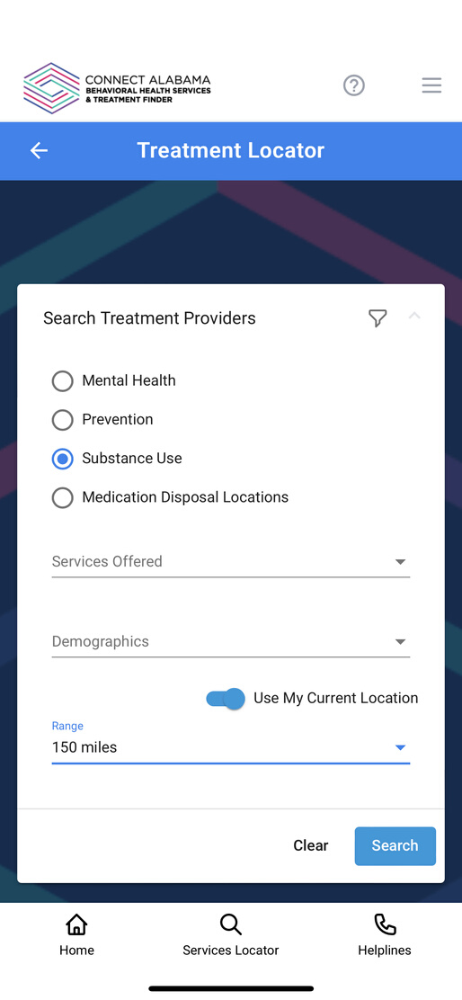
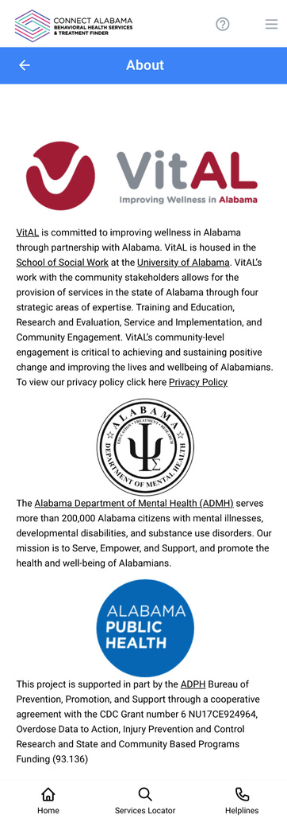
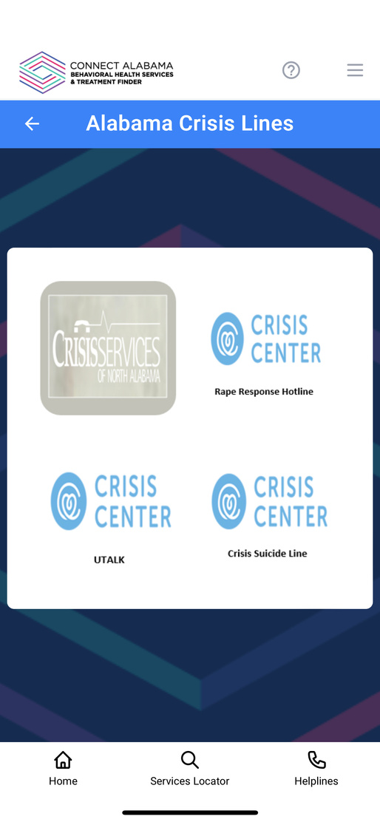
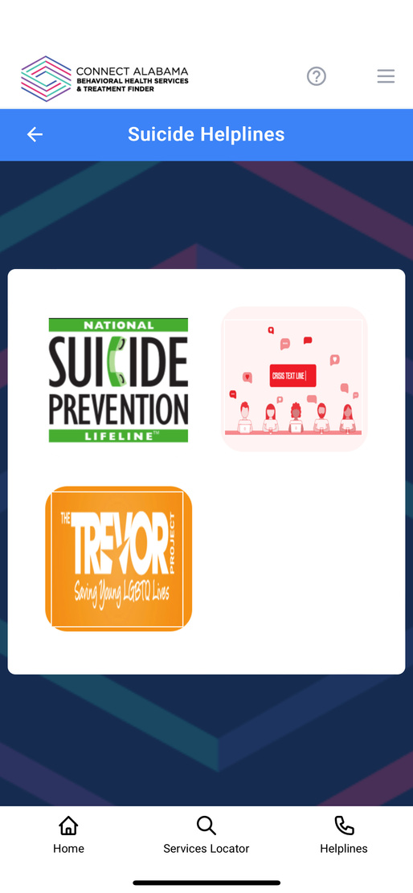



Why Connect Alabama?
Substance
Use
Mental
Health
Prevention
Treatment
Notes:
The Connect Alabama app is intended to be easy to use and provide timely information for anyone looking for treatment services information about substance use, mental health and prevention.
Because everything you need to know is in this single application, the process of learning about and connecting to treatment is streamlined and efficient.
Connect Alabama helps First Responders and healthcare providers direct people they encounter to information and treatment for mental health, substance use and prevention without the need to have handouts for every situation. Helping someone download Connect Alabama puts information in their hands and helps them search for solutions that can help them.
First Responders can also access or demonstrate how to access emergency information such as poison control, abuse, and suicide helplines.

Slide 34


Learn more
about the
Connect Alabama
App
Help is in your hands
Connect Alabama
https://youtu.be/9gyUeFUGCPs

Slide 35






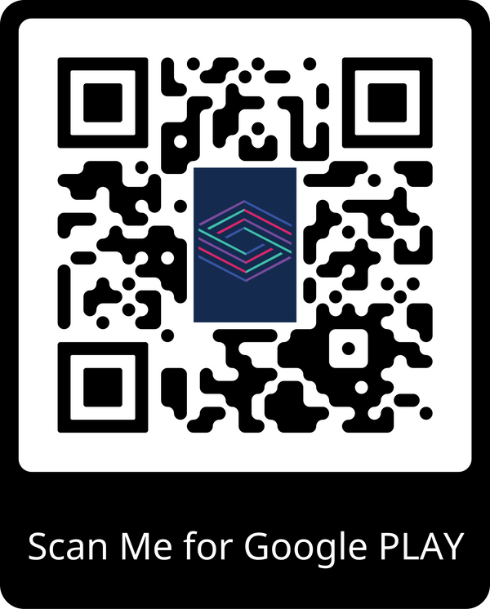
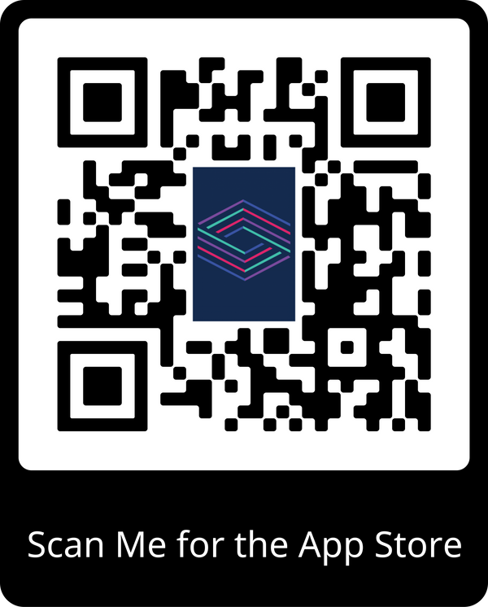
DOWNLOAD THE
CONNECT ALABAMA
APP TODAY!
Notes:
Direct your team or clients to Download the CONNECT Alabama APP TODAY on the Google Play or in the APP store or visit the VitAL website at www.vital

Slide 36
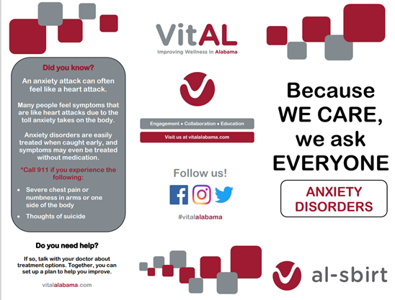
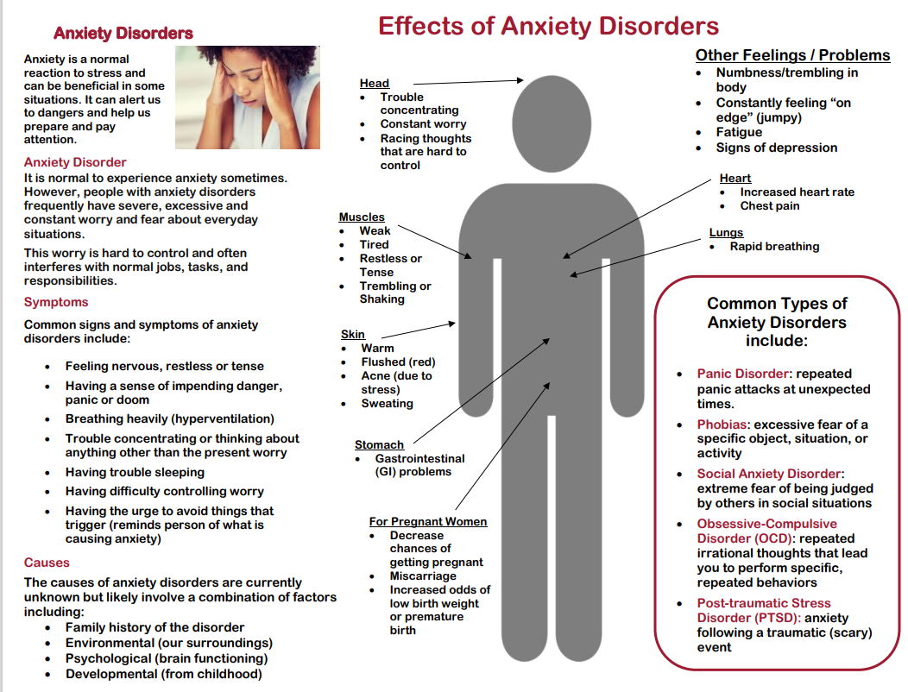
Patient Brochures
Brochure Topics:
Anxiety
Bipolar Disorder
Depression
Eating Disorders
PTSD
Post-partum Depression
Schizophrenia
Suicide
Notes:
Given to patient during or after they have received a BI!
You can see the various mental health brochure topics on the slide.

Slide 37
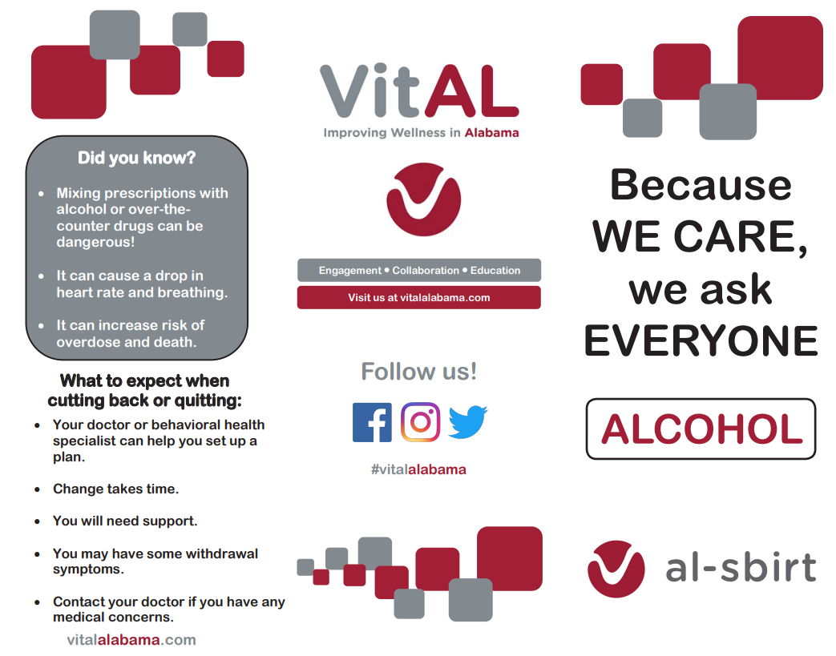
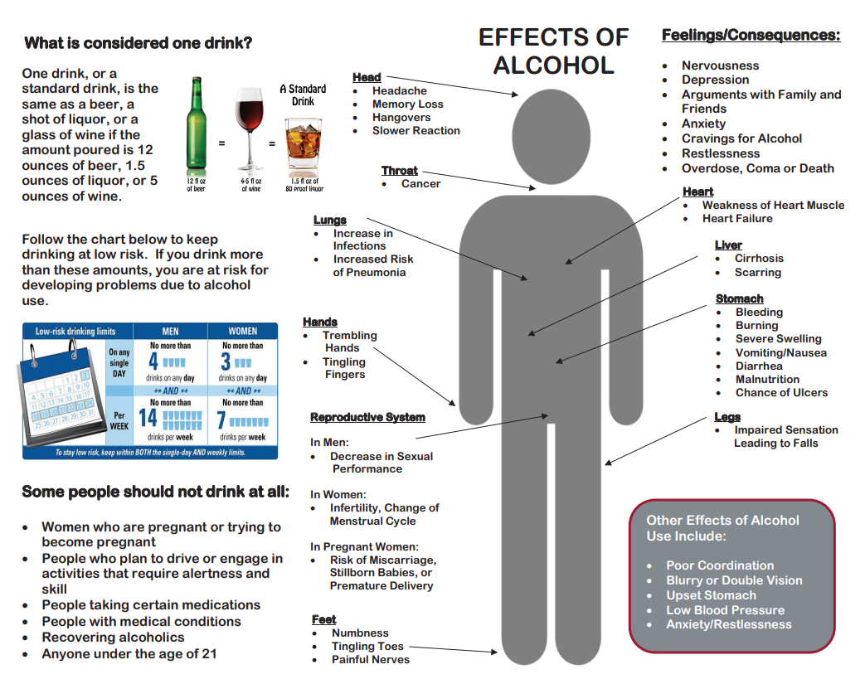
Brochure Topics:
Alcohol
Cocaine
Hallucinogens
Heroin
HIV and Substance Use
Prescription Depressants
Methamphetamines
Opioids
Marijuana
Smokeless Tobacco
Smoking/Nicotine
Stimulants
Synthetic Marijuana
Vaping
Notes:
These are additional patient brochures that can be provided to patients.
You can see the list of substance use topics on the slide.
Can be used to show patients the effects of their alcohol or drug use.
The brochures can be found on our website…. www.vitalalabama.com

Slide 38



Shanna McIntosh, MS, AADC
VitAL Director
University of Alabama
Email: semcintosh@ua.edu
Audra Toney, MSW
VitAL Project Coordinator
University of Alabama
Email: awtoney@ua.edu
For more information about VitAL and how we are working to improve wellness in Alabama, please visit us at vitalalabama.com
You can also follow us on social media!
@VitALalabama

